Slide 1
Manson School District Technology 2022-2023
Susan Sears
Technology Coordinator

Slide 2
Operational Technology
New Printers/Copiers
District Office – 1
Secondary – 3
Elementary – 3
New power supply for the network
New server for the phones
New file/active directory servers

Slide 3
Operational Technology (cont.)
Regular assigned tasks
Maintenance of student and teacher computers
Maintenance of classroom printers
Maintenance and replacement of school projectors

Slide 4
Grants
Digital Equity and Inclusion Grant
2021-2022
Awarded $38,943.00 for equipment and training
iPads
Mobile Device Management (MDM) software
Chargers and cases
Tech support and training
2022-2023
Awarded $77,000.00 for technology support and training
Additional tech support hours to prepare 1:1 devices for 2022-2023 school year
Stipends for teachers to offer training in technology integration
Training conferences for tech staff and teachers
Consultation services for school district technology

Slide 5
Grants (cont.)
Emergency Connectivity Grant
2021-2022
Awarded $86,000.00
240 laptops purchased
2022-2023
Awarded $30.000.00
70 laptops purchased
Completes our 1:1 initiative

Slide 6
E-Rate Funding 2023-2024
E-Rate
A Federal Communications Commission (FCC) program to make telecommunications and information services more affordable for schools and libraries
Ranges from 20% - 90% discount for these services based on poverty level of school
Services are in two categories
Category 1: Network
Category 2: Equipment and services
Completed Request for Proposal (RFP)
Network support
Firewall appliance

Slide 7
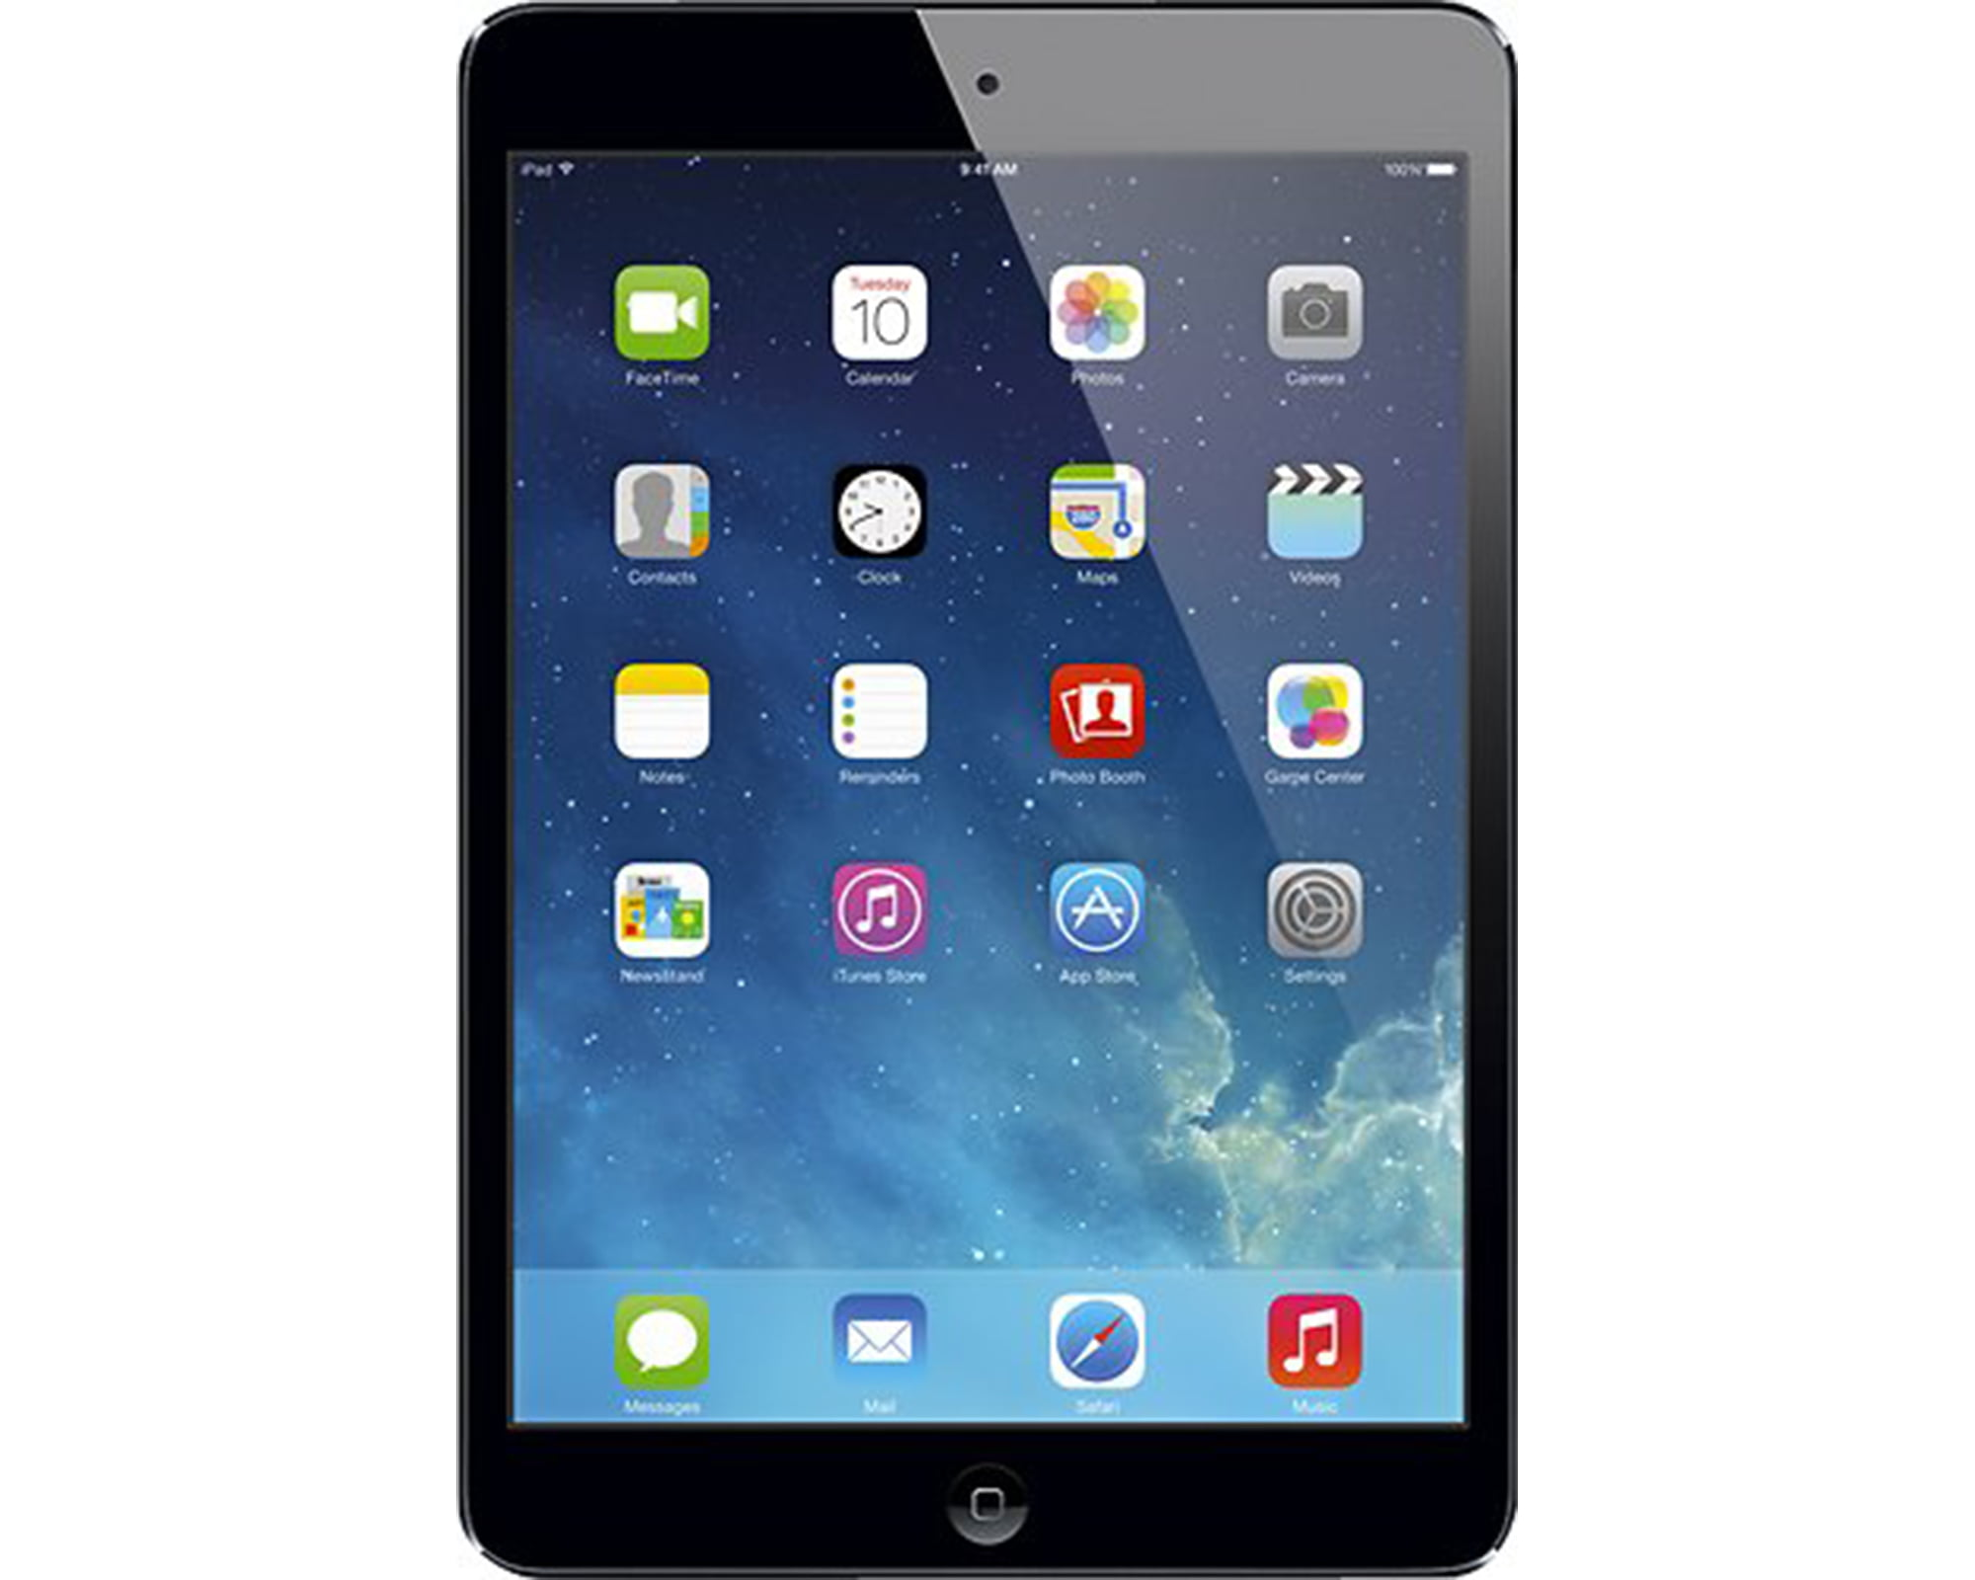
New Technology
Completion of 1:1 devices for all students
iPads
Kindergarten
1st grade
Laptops
2nd grade
Talking Points
Communication app between faculty and parent/guardians
Clever
Portal to house all apps for a single sign on (SSO) for elementary students
New Manson School District website

Slide 8
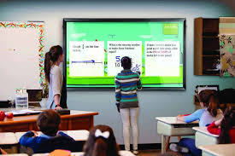
Upcoming Focus for Technology
Classroom Technology
Attended conference
Interactive display for instruction
Development of a technology plan to refresh student computers
How often?
Budget?

Slide 9
Questions ??

Slide 10
Thank you

